Slide 1
Math 642 Introduction to Machine Learning Lecture 10: Convolutional Neural Networks (part 2 of 2)
Some of the figures in this presentation are taken from "An Introduction to Statistical Learning, with applications in R" (Springer, 2013) with permission from the authors: G. James, D. Witten, T. Hastie and R. Tibshirani
This material is protected by copyright law. It is being provided to you in connection with Math 642 and as an accommodation during the current international health crisis. It may be used only by you for purposes of Math 642, and you may not copy, download or otherwise redistribute it for any other purpose.

Slide 2
Class Schedule
Lec | Date | Lecture | Due
1 | Jan 15 | Intro, Linear Regression, Bias and Variability
2 | Jan 22 | Unsupervised Learning: Clustering, Principle Comp. Analysis | Hwk 1
3 | Jan 29 | KNN Regression, Cross Validation, Bootstrap | Hwk 2
4 | Feb 5 | Ridge Regression, LASSO, Principle Components Regression | Hwk 3
5 | Feb 12 | Extreme Nonlinear: Step Functions, Splines, Gradient Descent | Hwk 4, Project Plan
6 | Feb 19 | Classification, Logistic Regression, Discriminant Analysis | Hwk 5
7 | Feb 26 | Max Margin Classifiers, Support Vector Machines | Hwk 6, Plan Revision
 | Mar 4 | Mid Term Exam
 | Mar 11 | Spring Break
8 | Mar 18 | Tree-Based Methods | Hwk 7
9 | Mar 25 | Neural Networks | Hwk 8
10 | Apr 1 | Neural Networks, Convolutional NN, Deep Learning | Hwk 9
11 | Apr 8 | Bayesian Analysis, Project Presentations | Hwk 10
12 | Apr 15 | Time Series, Project Presentations | Final Project Due
13 | Apr 22 | Ethics of Machine Learning, Project Presentations | Hwk 11
 | Apr 29 | Study Day
 | May 6 | Final Exam

Slide 3
Machine Learning Taxonomy
Statistical Learning
Outcomes
No Outcomes
Supervised
Unsupervised
Quantitative
Estimation
Outcome
is a Number
Outcome
is a Class
Classification
Clustering
Principal
Components
Logistic Regression
Parametric
Estimation
Non-Parametric
Estimation
Bayesian Belief Network
LDA/QDA
y = f(x)
non-equation
based
KNN Classification
Linear Regression
Common Elements
Cross Validation
Feature Selection
Gradient Descent
Bootstrap
Boosting
KNN Regression
SVM
Ridge Regression
Clustering
Decision Trees
LASSO
Decision Trees
Neural Nets
Splines
Time Series
Bayesian Modeling
Bayesian Modeling

Slide 4
Review from Last Week

Slide 5
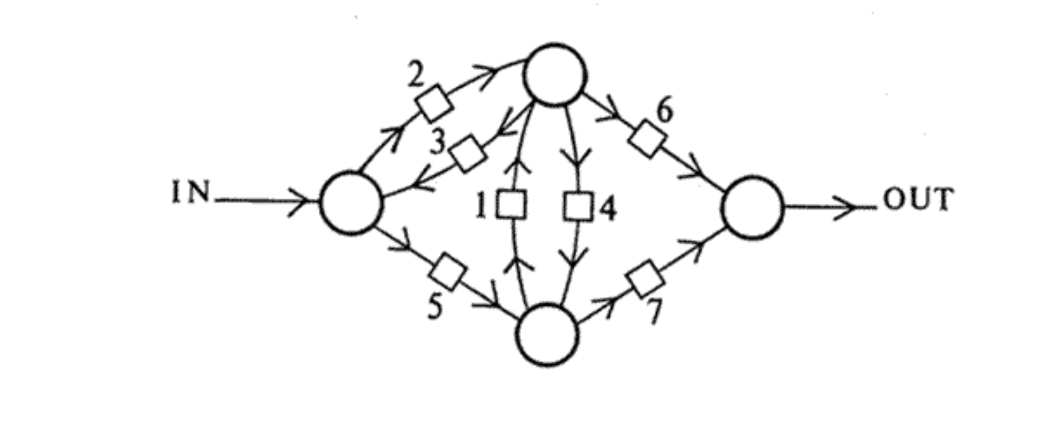
Neural Networks
Neural Networks have Been around for a while
But until recently, they were too cumbersome computationally to be of practical use.
From page 11 of Alan Turing’s 1948 paper “Intelligent Machinery”

Slide 6
Artificial Neural Network
Layer 1
Features
Hidden Layer(s)
2 to L
Layer L+1
Outcomes
(Estimates or
Classes)
1
1
⁞
1
W₀₁⁽¹⁾
W₀₁^{(L)}
x₁⁽¹⁾
a₁⁽²⁾
⁞
a₁^{(L)}
y₁^{(L+1)}
W₁₁⁽¹⁾
W_{1q}⁽¹⁾
W_{1k}^{(L)}
x₂⁽¹⁾
a₂⁽²⁾
⁞
y₂^{(L+1)}
a₂^{(L)}
⁞
⁞
⁞
⁞
W_{1q}⁽¹⁾
W_{1k}^{(L)}
x_{p}⁽¹⁾
a_{q}⁽²⁾
⁞
a_{r}^{(L)}
y_{k}^{(L+1)}
6

Slide 7
Notation
There are p Features labelled X_{j}
The k outcomes, or Classes, labelled Y_{k}
There are Hidden Layers denoted by ^{(L)}
There are q Activation Nodes a in the hidden layers. q can vary from layer to layer
The linear combinations of the prior weights and activation nodes are the activation arguments Z_{i,j}
The activation function is the sigmoid function, g(z) with a threshold 0.5.
Each layer has a constant term or a Bias
There are n Samples (X_{jn},Y_{n})

Slide 8
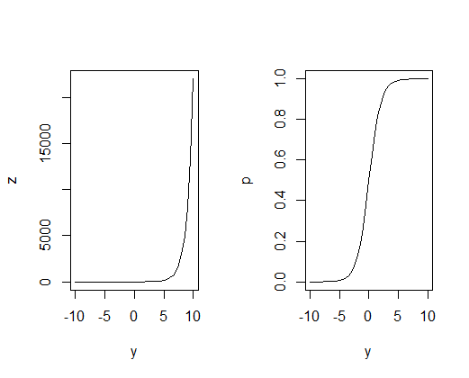
Activation
In general, there are only 2 outputs for a neuron
The output is either a “1” (electric pulse) or a “0” (no electric pulse)
The response is more like a sigmoid function than a linear function
Sigmoid Function
z = e^{y}
1 + e^{y}
Where y = β₀ + β₁x₁ + …
z=1
a
z=0
^
y
Predict 0
Predict 1

Slide 9
AND Gate
_{Bias}
₌ ₊₁
Q: What are the coefficients for the AND gate?
A: How about β₀ = -15, β₁ = +10, β₀ = +10.
β₀ =
x₁
_{Ŷ}
β₁ =
Ŷ = g(β₀ + β₁ * X₁+ β₂ * X₂)
x₂
β₂ =
X₁ | X₂ | Ŷ
1 | 1 | 1
1 | 0 | 0
0 | 1 | 0
0 | 0 | 0
ŷ=1
a
ŷ=0
^
Predict 0
Predict 1

Slide 10
OR Gate
₊₁
β₀ = - 20
x₁
_{Ŷ}
β₁ = 25
Ŷ = g(β₀ + β₁ * X₁+ β₂ * X₂)
x₂
β₂ = 25
X₁ | X₂ | Ŷ
1 | 1 | 1
1 | 0 | 1
0 | 1 | 1
0 | 0 | 0
ŷ=1
a
ŷ=0
^
Predict 0
Predict 1

Slide 11
NOR Gate
₊₁
β₀ = 20
x₁
_{Ŷ}
β₁ = -25
Ŷ = g(β₀ + β₁ * X₁+ β₂ * X₂)
x₂
β₂ = -25
X₁ | X₂ | Ŷ
1 | 1 | 0
1 | 0 | 0
0 | 1 | 0
0 | 0 | 1
ŷ=1
a
ŷ=0
^
Predict 0
Predict 1

Slide 12
Simple Example
W^{(L-1)}
W^{(L)}
y^{(L+1)}
a^{(L-1)}
a^{(L)}
y^{(L+1)} = Probability of Class
In this simple case, the outcome is
y^{(L+1)} = sigmoid(a^{(L)} * W^{(L)}) = σ(a^{(L)} * W^{(L)}) = σ(z^{(L)})
(note: because there is no bias in this example)
And the error is
J = [y - y^{(L+1)} ]² = [y - σ(z^{(L)})]²
In order to figure out how to modify W^{(L)}, we need to find δ J
δ W^{(L)}

Slide 13
Simple Example
W^{(L-1)}
W^{(L)}
a^{(L-1)}
a^{(L)}
y^{(L+1)}
y^{(L+1)} = Probability of Class
Remember the chain rule: for some function f(z), where z is a function of some other parameters x:
δ f = δ f δ z
δ x δ z δ x
*

Slide 14
Simple Example – Activation Node
W^{(L-1)}
W^{(L)}
a^{(L-1)}
a^{(L)}
y^{(L+1)}
y^{(L+1)} = Probability of Class
Using the chain rule:
δ J δ J^{(L)} δ y^{(L+1)} δ z^{(L+1)}
δ W^{(L)} δ y^{(L+1)} δ z^{(L)} δ W^{(L)}
=
*
*
δ J^{(L)}
δ y^{(L+1)}
δ z^{(L+1)}
δ W^{(L)}
= 2(y^{(L+1)}-y) = scalar
δ [a^{(L)} * W^{(L)}]
δ W^{(L)}
= a^{(L)}
=
Derivative of Sigmoid Function
So the size of the change in the error is proportional to the size of the error
This is the connection between the layers. Note each layer is dependent only the previous layer

Slide 15
Simple Example – Bias Node
1
W₀^{(L)}
a^{(L-1)}
a^{(L)}
y^{(L+1)}
W^{(L-1)}
W^{(L)}
y^{(L+1)} = Probability of Class
Using the chain rule:
δ J δ J^{(L)} δ y^{(L+1)} δ z^{(L+1)}
δ W^{(L)} δ y^{(L+1)} δ z^{(L)} δ W₀^{(L)}
=
*
*
δ J^{(L)}
δ y^{(L+1)}
δ z^{(L+1)}
δ W₀^{(L)}
= 2(y^{(L+1)}-y) = scalar
δ [1 * W₀^{(L)}]
δ W₀^{(L)}
= 1
=
Derivative of Sigmoid Function
So the size of the change in the error is proportional to the size of the error
For the bias, the derivative is just 1.

Slide 16
Backpropagation: Setup
Let’s take and example:
2 Features
1 Hidden Layer
1 Outcome (in this case a class)
1
W₀₁⁽¹⁾
1
W₀⁽²⁾
W₀₃⁽¹⁾
I skipped a few of the weights in the diagram to keep things readable
a₁⁽²⁾
W₁⁽²⁾
W₁₁⁽¹⁾
x₁⁽¹⁾
y₁⁽³⁾
W₁₂⁽¹⁾
W₂⁽²⁾
a₂⁽²⁾
W₃⁽²⁾
x₂⁽¹⁾
W₂₂⁽¹⁾
W₂₃⁽¹⁾
a₃⁽²⁾

Slide 17
Backpropagation: Putting it Together for n Samples
In matrix notation:
So you end up with each row in δJ / δW⁽²⁾ corresponding to a single hidden node in a hidden layer with all of your n samples. At a given point in the iteration all your samples add up to tell you to adjust your weight “up” or “down” at that node.
δJ / δW₀⁽²⁾
1
1
…
1
δ⁽³⁾₁
δJ / δW₁⁽²⁾
δ⁽³⁾₂
=
a₁₁⁽²⁾
a₁₂⁽²⁾
a_{1n}⁽²⁾
δJ / δW⁽²⁾ =
…
δJ / δW₂⁽²⁾
δ⁽³⁾₃
a₂₁⁽²⁾
a₂₂⁽²⁾
…
a_{2n}⁽²⁾
.
.
.
δJ / δW₃⁽²⁾
a₃₁⁽²⁾
a₃₂⁽²⁾
…
a_{3n}⁽²⁾
δ⁽³⁾_{n}

Slide 18
Backpropagation for the Inner Layer
δJ / δW₀₁⁽¹⁾
δJ / δW₀₂⁽¹⁾
δJ / δW₀₃⁽¹⁾
δJ / δW⁽¹⁾ =
δJ / δW₁₁⁽¹⁾
δJ / δW₁₂⁽¹⁾
δJ / δW₁₃⁽¹⁾
δJ / δW₂₁⁽¹⁾
δJ / δW₂₂⁽¹⁾
δJ / δW₂₃⁽¹⁾
1
1
…
1
δ₁₁⁽³⁾
δ₂₁⁽³⁾
δ₃₁⁽³⁾
=
δ₁₂⁽³⁾
δ₂₂⁽³⁾
δ₃₂⁽³⁾
X₁₁⁽¹⁾
X₁₂⁽¹⁾
X_{1n}⁽¹⁾
…
δ₂₃⁽³⁾
δ₃₃⁽³⁾
δ₁₃⁽³⁾
X₂₁⁽¹⁾
X₂₂⁽¹⁾
…
X_{2n}⁽¹⁾
.
.
.
.
.
.
.
.
.
δ_{1n}⁽³⁾
δ_{2n}⁽³⁾
δ_{3n}⁽³⁾

Slide 19
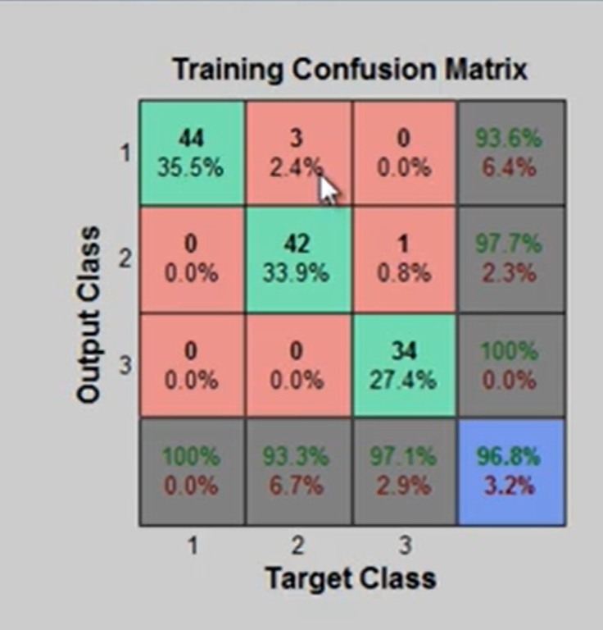
Confusion Matrix for Higher Dimensions
Confusion Matrices are easily extended to higher dimensionality. They can tell you not just which predictions were wrong, but how they were wrong. This is valuable if 2 classes are similar in some way and easily misclassified.

Slide 20
Convolutional Neural Networks Deep Learning

Slide 21
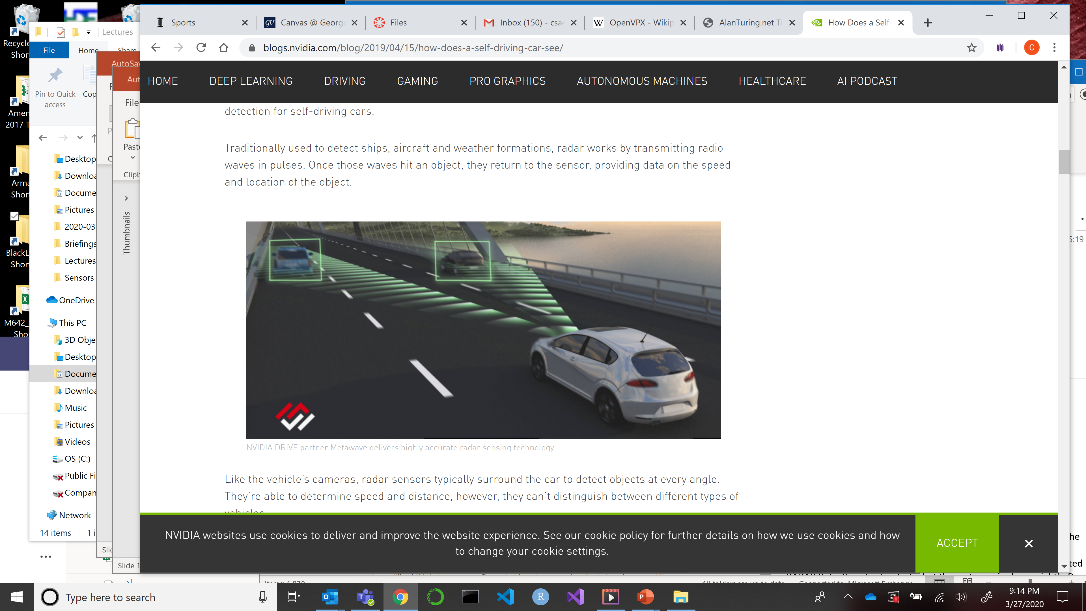
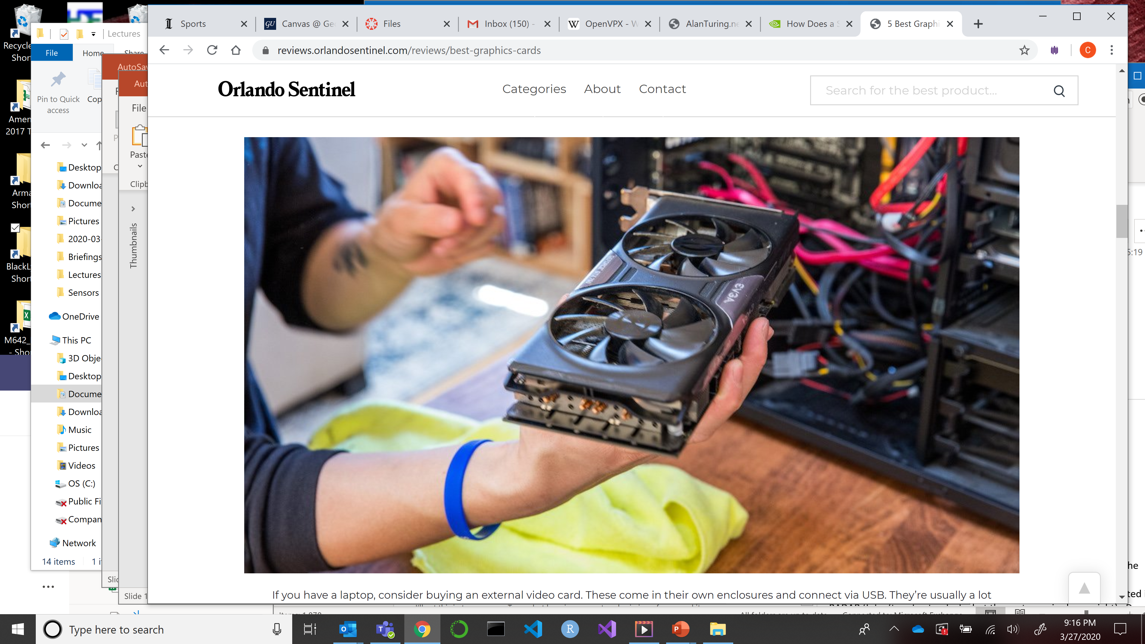
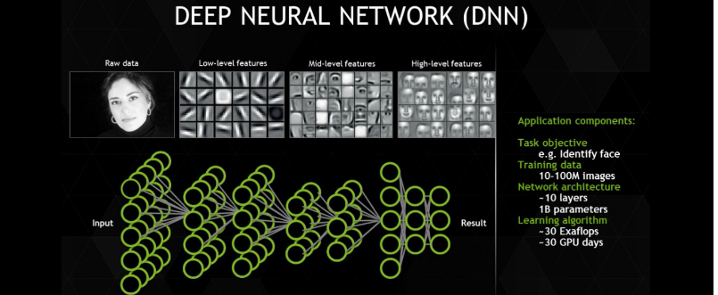
We are Witnessing a Revolution
Three technologies have matured to create leap in machine learning capability
Smaller Sensors
Commercial Graphical Processing Units
(and Field Programmable Gate Arrays)
Better Algorithms

Slide 22
Smaller Sensors
Examples of the sensors that are sources for neural networks
EO (visible spectrum, color or black and white)
Personal cameras
Street and business surveillance cameras
Remote sensing of Earth
Medical fiber optic scopes
RADAR (various bands of the spectrum, primarily X, L, or C band)
Range finders and geolocation devices
Imaging RADAR, Synthetic Aperture Radar (SAR)
InfraRed (just out of the visible spectrum, heat sensitive)
Night vision
Military firings
LIDAR
Hyper-Spectral Imaging
Other Medical Sensors
Magnetic Resonance Images
Echocardiograms and Sonograms

Slide 23
Systems with Sensors
These are some systems employing the sensors and using neural networks
Self Driving Cars
Road and hazard sensing using EO, Radar, LIDAR
Medical Diagnosis
Detecting tumors from biopsy sections under a microscope
Anti-Terrorism
Facial Recognition
Remote Sensing
Estimating crop acreage and yields worldwide
Ice mapping in the oceans for shipping
Stock Market
Predicting trends using time series data as input
Disaster Relief
Determining ingress and egress after hurricanes, earthquakes
Urban Planning
Transportation Construction based on traffic patterns and population

Slide 24
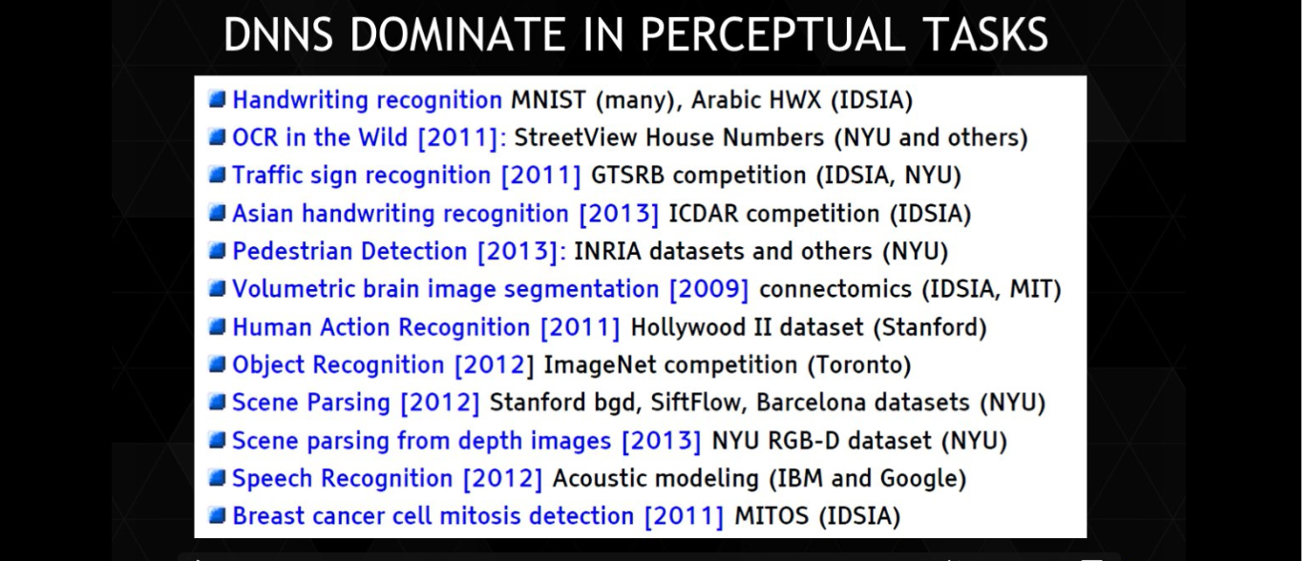
Deep Neural Nets Have Tens or Hundreds of Layers
Reference NVIDIA GPU Webinar

Slide 25
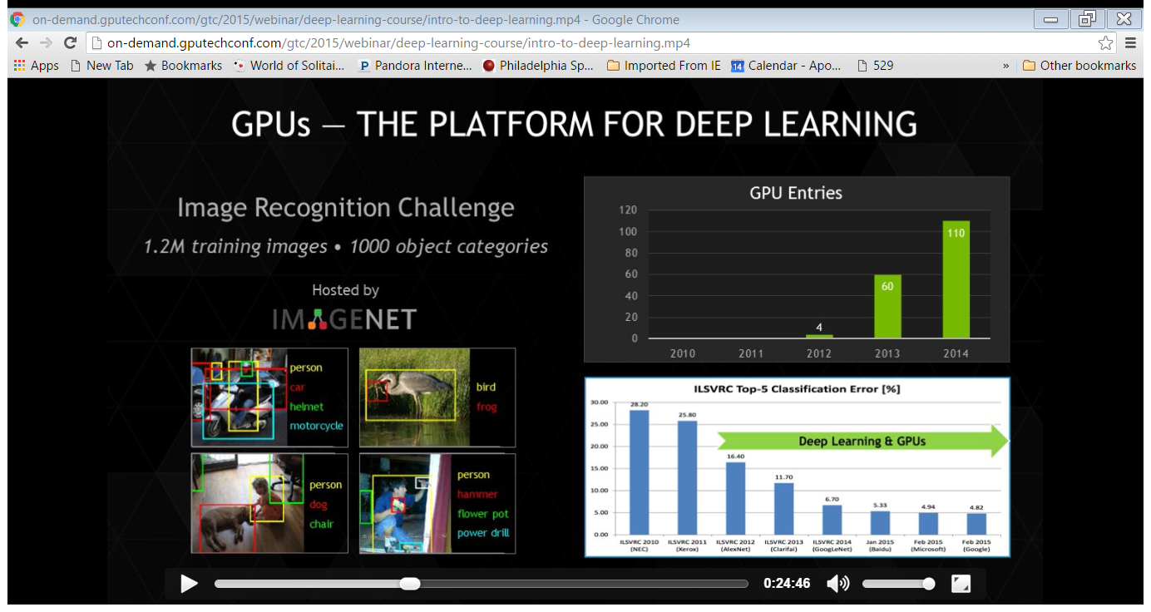
ImageNet Large-Scale Visual Recognition Challenge
ILSVRC competition can be thought of as the annual Olympics of computer vision, where teams from across the world compete to see who has the best computer vision model for tasks such as classification, localization, detection, and more. 2012 marked the first year where a CNN was used to achieve a top 5 test error rate of 15.4% (Top 5 error is the rate at which, given an image, the model does not output the correct label with its top 5 predictions). The next best entry achieved an error of 26.2%, which was an astounding improvement that pretty much shocked the computer vision community. Safe to say, CNNs became household names in the competition from then on out.
Reference NVIDIA GPU Webinar

Slide 26
Graphical Processing Units (GPUs)
Recent advancements in computers driven by gaming have enabled “Deep Learning”
Reference NVIDIA GPU Webinar

Slide 27
Convolution in 1 Dimension
2
1
0
f(k)
k
0 1 2 3 4 5 6
(f*g)(x)=$\int_{−∞}^{∞}{f\left(k\right)g\left(x−k\right)dk}$

Slide 28
Convolution in 1 Dimension
2
1
0
g(x-k)
where k = 0
k
0 1 2 3 4 5 6
(f*g)(x)=$\int_{−∞}^{∞}{f\left(k\right)g\left(x−k\right)dk}$

Slide 29
Convolution in 1 Dimension
2
1
0
g(x-k)
where k = 0
f(k)
k
0 1 2 3 4 5 6
(f*g)(x)=$\int_{−∞}^{∞}{f\left(k\right)g\left(x−k\right)dk}$

Slide 30
Convolution in 1 Dimension
2
1
0
g(x-k)
where k = 2
f(k)
k
0 1 2 3 4 5 6
(f*g)(x)=$\int_{−∞}^{∞}{f\left(k\right)g\left(x−k\right)dk}$

Slide 31
Convolution in 1 Dimension
2
1
0
g(x-k)
where k = 2.8
f(k)
k
1
0
0 1 2 3 4 5 6
The convolution is the overlap between f and g
k
0 1 2 3 4 5 6
(f*g)(x)=$\int_{−∞}^{∞}{f\left(k\right)g\left(x−k\right)dk}$

Slide 32
Convolution in 1 Dimension
2
1
0
g(x-k)
where k = 3
f(k)
k
1
0
0 1 2 3 4 5 6
k
0 1 2 3 4 5 6
(f*g)(x)=$\int_{−∞}^{∞}{f\left(k\right)g\left(x−k\right)dk}$

Slide 33
Convolution in 1 Dimension
2
1
0
g(x-k)
where k = 3.7
f(k)
k
1
0
0 1 2 3 4 5 6
k
0 1 2 3 4 5 6
(f*g)(x)=$\int_{−∞}^{∞}{f\left(k\right)g\left(x−k\right)dk}$

Slide 34
Convolution in 1 Dimension
2
1
0
g(x-k)
where k = 4
f(k)
k
1
0
0 1 2 3 4 5 6
k
0 1 2 3 4 5 6
(f*g)(x)=$\int_{−∞}^{∞}{f\left(k\right)g\left(x−k\right)dk}$

Slide 35
Convolution in 1 Dimension
2
1
0
g(x-k)
where k = 5
f(k)
k
1
0
0 1 2 3 4 5 6
k
0 1 2 3 4 5 6
(f*g)(x)=$\int_{−∞}^{∞}{f\left(k\right)g\left(x−k\right)dk}$

Slide 36
R Convolution Example

Slide 37
R Convolution Example

Slide 38
2-Dimensional Convolution
A 2-D convolution works like the 1-D case. Assume the data was scaled for an average of 0 and std deviation of 1 before doing the convolution. Assume the convolution set any result smaller than 0.8 = 0.
**
=
Kernel
Image
Result
(f**g)(x,y)=$\int_{−∞}^{∞}{\int_{−∞}^{∞}{f\left(k,m\right)g\left(x−k,y−m\right)dk dm}}$

Slide 39
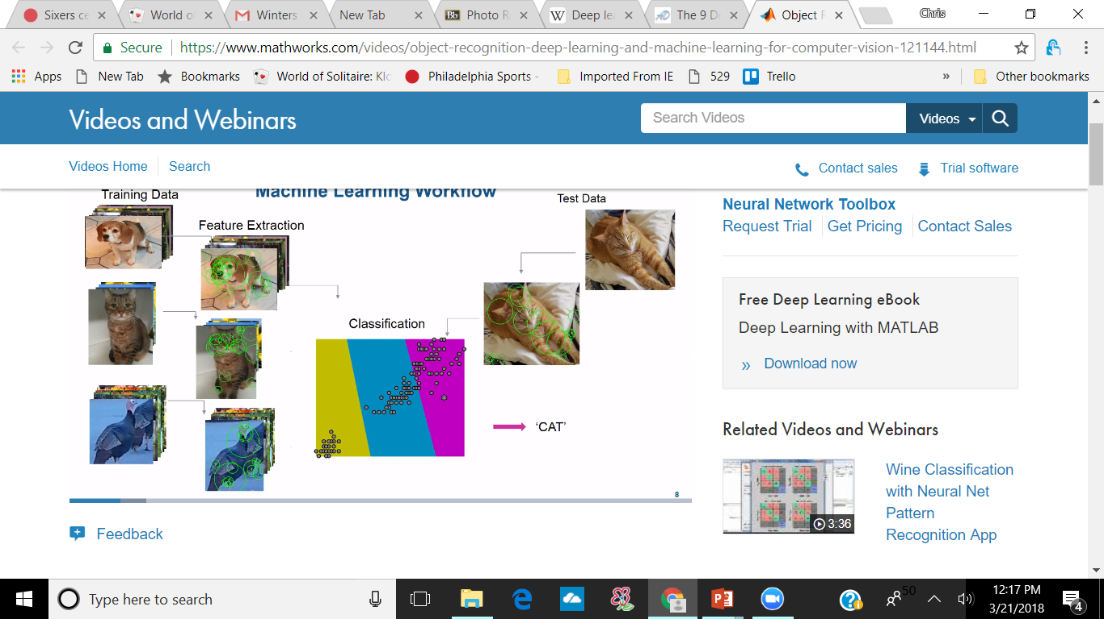
2-D Convolution
**
**
=

Slide 40
Clustering Based on Convolution Filters

Slide 41
Slide and Pad
You don’t need to perform the convolution on every pixel
Slide is the number of pixels you move the convolution filter (up/down and left/right) between applications
Pad is how many pixels you leave between applications of the filter
Pooling is a means of reducing the pixels in the image. Often you can pool a group of pixels to just one value. Pooling can be max, min, average, or another methodology, depending on the application.

Slide 42
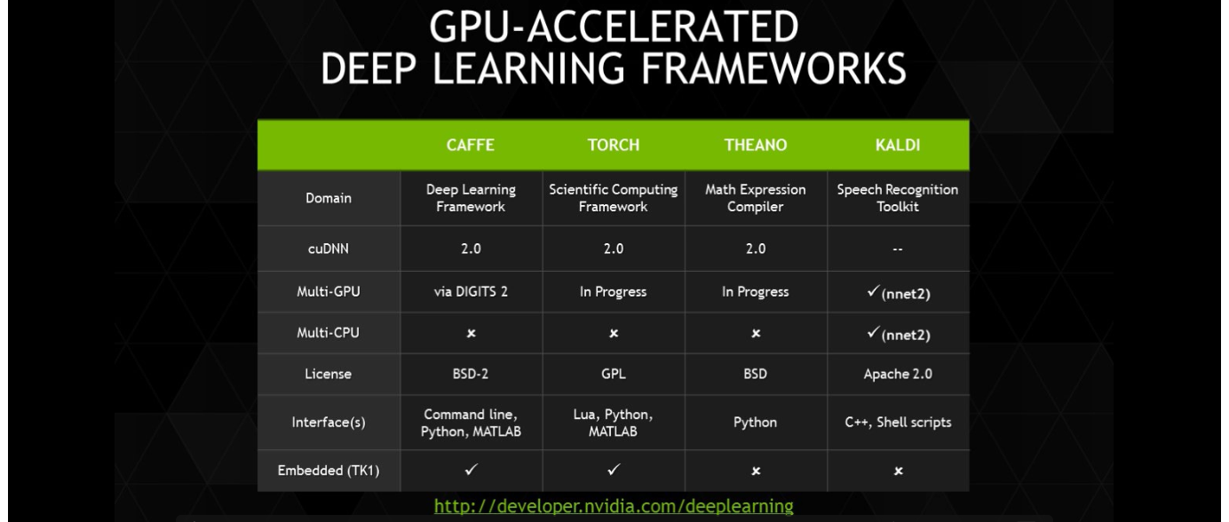
Best GPU Enabled ANN Software
Reference NVIDIA GPU Webinar

Slide 43
ANNs are Processing Hogs
By now I’m sure you realized that training a large neural network could involve millions or billions of calculations.
Example:
You have 1000 pictures of animals you want the ANN to categorize
You have 1.2M training pictures pictures of these animals
Each image is between 10⁶ and 10⁸ pixels
You architect a neural network with 100 hidden layers
Graphical Processing Units (GPU’s) are ideally suited for training ANNs

Slide 44
GPU’s
In the 1970’s, displays for computer games were too slow to keep up with the action. Gaming companies developed hardware that stored data for the next frame while displaying the current frame, speeding up the action.
In the 1980’s, graphic chips and video boards went from 16 color bitmaps to 16 million color bitmaps in less than 10 years. 2D graphics turned into more realistic 3D.
In 2000 NVIDIA produced the first true Graphical Processing Unit that could handle pixel by pixel processing. It was massively parallel, meaning it could do the same calculation many times simultaneously.
Since GPU’s use vector and matrix operations, they can be used for many applications, not just video.

Slide 45
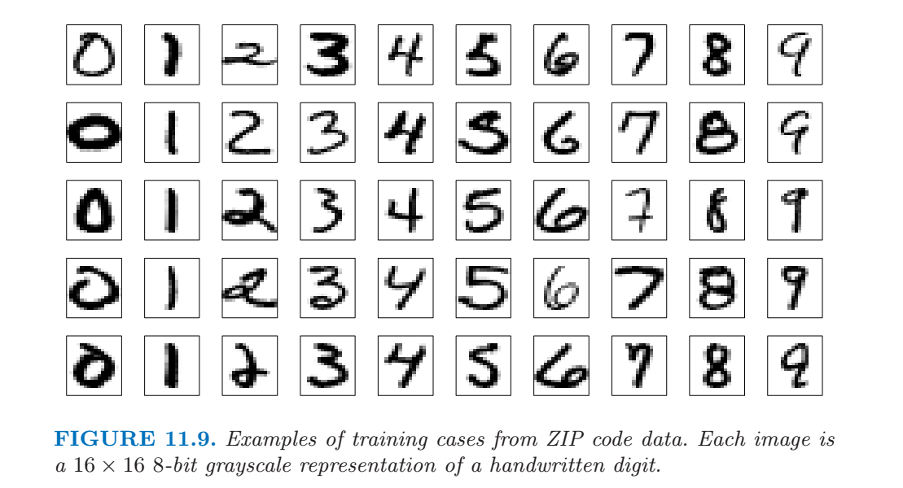
Neural Net Example

Slide 46
Neural Network Art
How did Mike Tyke create art, music, and text from neural networks?
DeepDream is one technique for generating new images using a trained artificial neural network. The process works as follows. A initial picture or simply random noise is shown to the network which will then visually parse and interpret it. We then calculate how to change the picture incrementally in order to enhance that initial interpretation. The process is repeated until an image appears.
The complexity of the interpretation that the neural network obtains varies where in the network this interpretation is intercepted. Neurons that are closer to the input image will respond to simple features while neurons deep in the network will respond to more complex ones. Thus depending on the depth of the neural network layer that’s targeted, different forms and features are obtained often leading to interesting new recombinations of knowledge elements the network has learned. Many different forms are possible from simple geometric patterns to psychedelic looking combinations of entire concepts.

Slide 47
Deep Learning in 3D

Slide 48
Problems with Neural Networks
The Number 1 practical problem with Neural Networks: They need lots (and lots, think tens of thousands or millions) of curated data in order to train the model
Finding the right architecture is an art not a science
The final model is a black box that is difficult to explain, both in how you got the model and how it works
What are the main things your model uses to come up with a classification?
Therefore not great if you are looking for insight

Slide 49
Transfer Learning
Goal – Use a pre-trained CNN to handle a new situation, without having a full dataset
Typically you alter the last layer
You might make the last layer fully connected
You might up the learning rate
You might change the max # epochs
You can add pooling layers
Basically you are taking a model that can already “see” and making it recognize a new object
Usually you can set the learning parameter per layer, so you can have the final layer(s) adjust quickly while keeping the original CNN stable.

Slide 50
Homework 10
Problem 1
Using the R code posted as an example, create a neural network that learns how to multiply 2 numbers from 1 to 10 together. Try different numbers of nodes per layer and number of hidden layers. Plot the best neural network and describe the model. Describe how accurate the results are in each case.
Problem 2
Create a neural network that predicts a hitters salary will be above the median or below using the Hitters Dataset. You will have to create a variable “above median salary” and “below median salary”.
Due April 8

Slide 51
Homework 10
Apply a simple neural network to your project data using R. Describe how well it worked and if you think it is a good model for your applications.
No need to hand this in now, but include it in your appendix for your project.

Slide 52
Autonomous Driving Video
https://www.youtube.com/watch?v=jet4vwPUfh8
https://www.youtube.com/watch?v=0qVOUD76JOg&ebc=ANyPxKrkhStZLZKuuDFgiBRB5QMs_uxV5qbwvEzsG-GlzOAlAy10mMjLJXcuzh6hyRbOSsfUNF_NwK1EykPR5XmoX87uwJqSlA&nohtml5=False

Slide 53
Points to Ponder
How can such a simple cell with a binary core processor be the basis for all of human civilization?
Why is this design so “flexible”… how does it avoid learning problems that we have discussed?
Is this the optimal ML solution or just one step in a future design?
Is someone from this class going to be the developer that puts the neural net out of business?
How far can we push deep learning? Is neural net architecture the basis for passing the Turing test? Could it be an answer to achieving consciousness with a machine?

